Slide 1
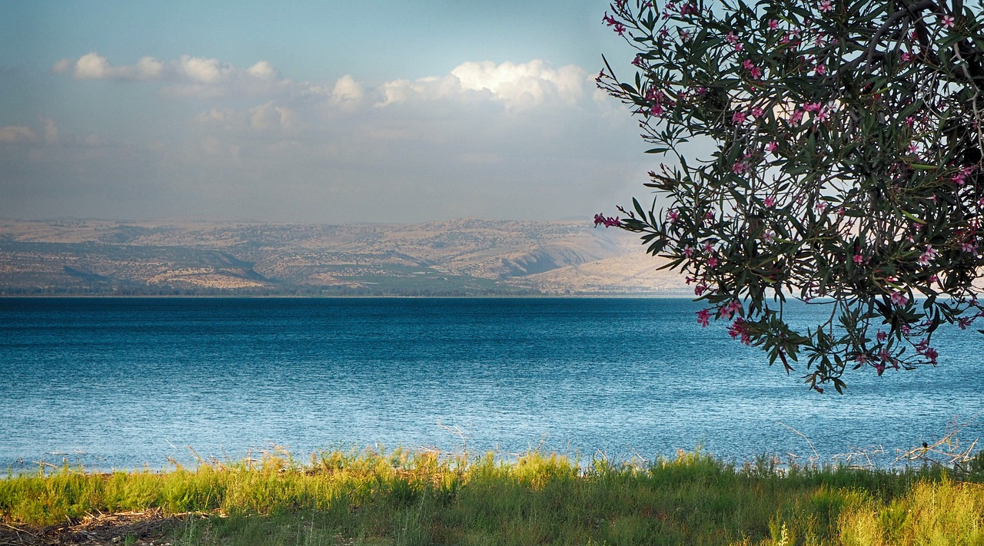
Legacy of Faith: Faith in Action
Hebrews 11:20-29
December 8, 2024

Slide 2
Hebrews 11:20-24
²⁰ By faith Isaac blessed Jacob and Esau in regard to their future. ²¹ By faith Jacob, when he was dying, blessed each of Joseph’s sons, and worshiped as he leaned on the top of his staff. ²² By faith Joseph, when his end was near, spoke about the exodus of the Israelites from Egypt and gave instructions concerning the burial of his bones. ²³ By faith Moses’ parents hid him for three months after he was born, because they saw he was no ordinary child, and they were not afraid of the king’s edict. ²⁴ By faith Moses, when he had grown up, refused to be known as the son of Pharaoh’s daughter.

Slide 3
Hebrews 11:25-29
²⁵ He chose to be mistreated along with the people of God rather than to enjoy the fleeting pleasures of sin. ²⁶ He regarded disgrace for the sake of Christ as of greater value than the treasures of Egypt, because he was looking ahead to his reward. ²⁷ By faith he left Egypt, not fearing the king’s anger; he persevered because he saw him who is invisible. ²⁸ By faith he kept the Passover and the application of blood, so that the destroyer of the firstborn would not touch the firstborn of Israel. ²⁹ By faith the people passed through the Red Sea as on dry land; but when the Egyptians tried to do so, they were drowned.

Slide 4
Legacy of Faith: Faith in Action
I. Faith in Death (11:20-22)
A. The dying faith of Isaac (20)
By faith Isaac blessed Jacob and Esau in regard to their future.

Slide 5
Genesis 26:1-7
Now there was a famine in the land, besides the previous famine that had occurred in the days of Abraham. So Isaac went to Gerar, to Abimelech king of the Philistines. ² The Lord appeared to him and said, “Do not go down to Egypt; stay in the land of which I shall tell you. ³ Sojourn in this land and I will be with you and bless you, for to you and to your descendants I will give all these lands, and I will establish the oath which I swore to your father Abraham. ⁴ I will multiply your descendants as the stars of heaven, and will give your descendants all these lands; and by your descendants all the nations of the earth shall be blessed; ⁵ because Abraham obeyed Me and kept My charge, My commandments, My statutes and My laws.”
⁶ So Isaac lived in Gerar. ⁷ When the men of the place asked about his wife, he said, “She is my sister,” for he was afraid to say, “my wife,” thinking, “the men of the place might kill me on account of Rebekah, for she is beautiful.”

Slide 6
Legacy of Faith: Faith in Action
I. Faith in Death (11:20-22)
A. The dying faith of Isaac (20)
B. The dying faith of Jacob (21)
By faith Jacob, when he was dying, blessed each of Joseph’s sons, and worshiped as he leaned on the top of his staff.

Slide 7
Genesis 47:9
The years of my sojourning are one hundred and thirty; few and unpleasant have been the years of my life, nor have they attained the years that my fathers lived during the days of their sojourning.

Slide 8
Genesis 48:21
Behold, I am about to die, but God will be with you, and bring you back to the land of your fathers.

Slide 9
Legacy of Faith: Faith in Action
I. Faith in Death (11:20-22)
A. The dying faith of Isaac (20)
B. The dying faith of Jacob (21)
C. The dying faith of Joseph (22)
By faith Joseph, when his end was near, spoke about the exodus of the Israelites from Egypt and gave instructions concerning the burial of his bones.

Slide 10
Genesis 50:24-25
Joseph said to his brothers, “I am about to die, but God will surely take care of you and bring you up from this land to the land which He promised on oath to Abraham, to Isaac and to Jacob.” ²⁵ Then Joseph made the sons of Israel swear, saying, “God will surely take care of you, and you shall carry my bones up from here.”

Slide 11
Legacy of Faith: Faith in Action
II. Faith in Living (11:23-29)
A. Faith rejects the world’s influences (24-29)

Slide 12
Legacy of Faith: Faith in Action
II. Faith in Living (11:23-29)
A. Faith rejects the world’s influences (24-29)
Faith rejects the world’s prestige (24)
By faith Moses, when he had grown up, refused to be known as the son of Pharaoh’s daughter.

Slide 13
Baron Justinian von Weltz
“What is it to me to bear the title ‘well-born,’ when I am born again to Christ? What is it to me to have the title “lord,’ when I desire to be the servant of Christ? What is it to be called, ‘your grace,’ when I have need of God’s grace? All these vanities I will away with and all else I will lay at the feet of my dear Lord Jesus.”

Slide 14
Legacy of Faith: Faith in Action
II. Faith in Living (11:23-29)
A. Faith rejects the world’s influences (24-29)
Faith rejects the world’s prestige (24)
Faith rejects the world’s pleasure (25)
He chose to be mistreated along with the people of God rather than to enjoy the fleeting pleasures of sin.

Slide 15
Legacy of Faith: Faith in Action
II. Faith in Living (11:23-29)
A. Faith rejects the world’s influences (24-29)
Faith rejects the world’s prestige (24)
Faith rejects the world’s pleasure (25)
Faith rejects the world’s plenty (26)
He regarded disgrace for the sake of Christ as of greater value than the treasures of Egypt, because he was looking ahead to his reward.

Slide 16
Legacy of Faith: Faith in Action
II. Faith in Living (11:23-29)
A. Faith rejects the world’s influences (24-29)
Faith rejects the world’s prestige (24)
Faith rejects the world’s pleasure (25)
Faith rejects the world’s plenty (26)
Faith rejects the world’s pressure (27)
By faith he left Egypt, not fearing the king’s anger; he persevered because he saw him who is invisible.

Slide 17
Legacy of Faith: Faith in Action
II. Faith in Living (11:23-29)
A. Faith rejects the world’s influences (24-29)
B. Faith accepts God’s word (23; 28-29)
Matthew 2:13
An angel of the Lord appeared to Joseph in a dream and said, “Get up! Take the Child and His mother and flee to Egypt, and remain there until I tell you; for Herod is going to search for the Child to destroy Him.”

Slide 18
Legacy of Faith: Faith in Action
II. Faith in Living (11:23-29)
A. Faith rejects the world’s influences (24-29)
B. Faith accepts God’s word (23; 28-29)
Faith accepts God’s plans (23)
By faith Moses’ parents hid him for three months after he was born, because they saw he was no ordinary child, and they were not afraid of the king’s edict.

Slide 19
Act 4:19-20
¹⁹ But Peter and John answered and said to them, “Whether it is right in the sight of God to give heed to you rather than to God, you be the judge; ²⁰ for we cannot stop speaking about what we have seen and heard.”

Slide 20
Legacy of Faith: Faith in Action
II. Faith in Living (11:23-29)
A. Faith rejects the world’s influences (24-29)
B. Faith accepts God’s word (23; 28-29)
Faith accepts God’s plans (23)
Faith accepts God’s provision (28)
By faith he kept the Passover and the application of blood, so that the destroyer of the firstborn would not touch the firstborn of Israel.

Slide 21
Legacy of Faith: Faith in Action
II. Faith in Living (11:23-29)
A. Faith rejects the world’s influences (24-29)
B. Faith accepts God’s word (23; 28-29)
Faith accepts God’s plans (23)
Faith accepts God’s provision (28)
Faith accepts God’s promise (29)
By faith the people passed through the Red Sea as on dry land; but when the Egyptians tried to do so, they were drowned.

Slide 22
Exodus 14:12-16
¹² Is this not the word that we spoke to you in Egypt, saying, Leave us alone that we may serve the Egyptians? For it would have been better for us to serve the Egyptians than to die in the wilderness.” ¹³ But Moses said to the people, “Do not fear! Stand by and see the salvation of the Lord which He will accomplish for you today; for the Egyptians whom you have seen today, you will never see them again forever. ¹⁴ The Lord will fight for you while you keep silent.” ¹⁵ Then the Lord said to Moses, “Why are you crying out to Me? Tell the sons of Israel to go forward. ¹⁶ As for you, lift up your staff and stretch out your hand over the sea and divide it, and the sons of Israel shall go through the midst of the sea on dry land.

Slide 23
Thoughts and Application
Faith is not believing that God can do what He says, it is knowing that God will do what He says.
We do not need to question the viability, the reliability or the accountability of the promises of God.
There are only two questions to ask ourselves.
Do we fully rely upon the promises of God?
Do we trust that they will be fulfilled in His perfect timing?

Slide 24
Legacy of Faith: Faith in Action
Hebrews 11:20-29
December 8, 2024

